Slide 1
Microsoft SharePoint 2019 Training

Slide 2



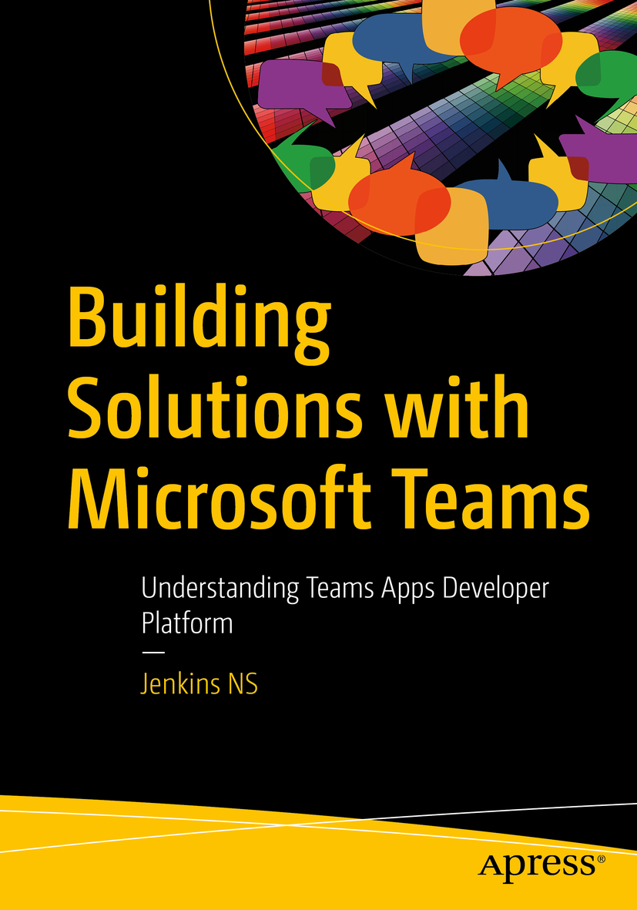








Jenkins NS
Modern Workplace Solution Architect | Consultant
Chennai, India
MVP | MCT | International Speaker | Author | Trainer
Microsoft Teams, Power Platform and SPFx Specialist
M365 Bangalore Organizer
aMS Ambassador
SharePoint-er Since 2005!
@jenkinsns
https://www.linkedin.com/in/jenkinsns/
http://www.jenkinsblogs.com
https://www.youtube.com/user/jenkinsnss
Notes:
Hyperlinks in PowerPoint are active for the attendees if you use PowerPoint Live sharing in Teams.

Slide 3
Module 1:Introduction to SharePoint 2019 Training

Slide 4
Module 1
Introduction to SharePoint 2019 Training
What’s new in SharePoint 2019
History of SharePoint
Identifying use cases for SharePoint
SharePoint New and improved Modern interface SharePoint 2019 Features
New Development options
Compare 2013, 2016 and 2019

Slide 5
What’s is SharePoint?
SharePoint is a web-based platform that allows you to create, share, and manage content, documents, and applications. It is part of the Microsoft 365 suite of products and services, and it can be used for various purposes, such as:
Collaborating with your team or organization on projects, tasks, and workflows
Storing and organizing your files in a secure and accessible way
Building and customizing websites, intranets, and portals
Integrating with other Microsoft 365 apps, such as Teams, OneDrive, and Outlook
Automating business processes and workflows with Power Automate
Creating and managing data and reports with Power BI
Notes:
SharePoint is a web-based platform that allows you to create, share, and manage content, documents, and applications. It is part of the Microsoft 365 suite of products and services, and it can be used for various purposes, such as:
Collaborating with your team or organization on projects, tasks, and workflows
Storing and organizing your files in a secure and accessible way
Building and customizing websites, intranets, and portals
Integrating with other Microsoft 365 apps, such as Teams, OneDrive, and Outlook
Automating business processes and workflows with Power Automate
Creating and managing data and reports with Power BI
SharePoint can be accessed from any device and any browser, and it offers different plans and options depending on your needs and preferences. You can use SharePoint Online, which is a cloud-based service hosted by Microsoft, or SharePoint Server, which is an on-premises solution that you can install and manage on your own servers. You can also use SharePoint Hybrid, which combines both online and server features.
SharePoint is a versatile and powerful tool that can help you work smarter and faster, as well as improve communication and collaboration within your organization. To learn more about SharePoint, you can visit the official website or check out the online training and resources available.

Slide 6
What’s new in SharePoint 2019
Modern user experience: SharePoint 2019 delivers a modern and intuitive user interface that adapts to different screen sizes and devices. It also provides new web parts, pages, and site templates that enable users to create engaging and dynamic sites and pages.
Improved performance and scalability: SharePoint 2019 leverages the latest technologies and standards to optimize performance and scalability. It also supports large file uploads, increased character limits, and faster site creation.
Enhanced security and compliance: SharePoint 2019 provides advanced security and compliance features that help protect data and meet regulatory requirements. It also supports encryption at rest and in transit, information rights management, and data loss prevention.
Richer collaboration and communication: SharePoint 2019 enables richer and more interactive collaboration and communication with features such as SharePoint Home, SharePoint Hub Sites, SharePoint Communication Sites, and SharePoint Team Sites. It also integrates with Microsoft Teams, Yammer, and Office 365 Groups.
Hybrid capabilities: SharePoint 2019 supports hybrid scenarios that allow users to access and manage content and services across SharePoint on-premises and SharePoint Online. It also provides hybrid search, hybrid taxonomy, and hybrid auditing capabilities.
Notes:
SharePoint is a web-based platform that allows you to create, share, and manage content, documents, and applications. It is part of the Microsoft 365 suite of products and services, and it can be used for various purposes, such as:
Collaborating with your team or organization on projects, tasks, and workflows
Storing and organizing your files in a secure and accessible way
Building and customizing websites, intranets, and portals
Integrating with other Microsoft 365 apps, such as Teams, OneDrive, and Outlook
Automating business processes and workflows with Power Automate
Creating and managing data and reports with Power BI
SharePoint can be accessed from any device and any browser, and it offers different plans and options depending on your needs and preferences. You can use SharePoint Online, which is a cloud-based service hosted by Microsoft, or SharePoint Server, which is an on-premises solution that you can install and manage on your own servers. You can also use SharePoint Hybrid, which combines both online and server features.
SharePoint is a versatile and powerful tool that can help you work smarter and faster, as well as improve communication and collaboration within your organization. To learn more about SharePoint, you can visit the official website or check out the online training and resources available.

Slide 7
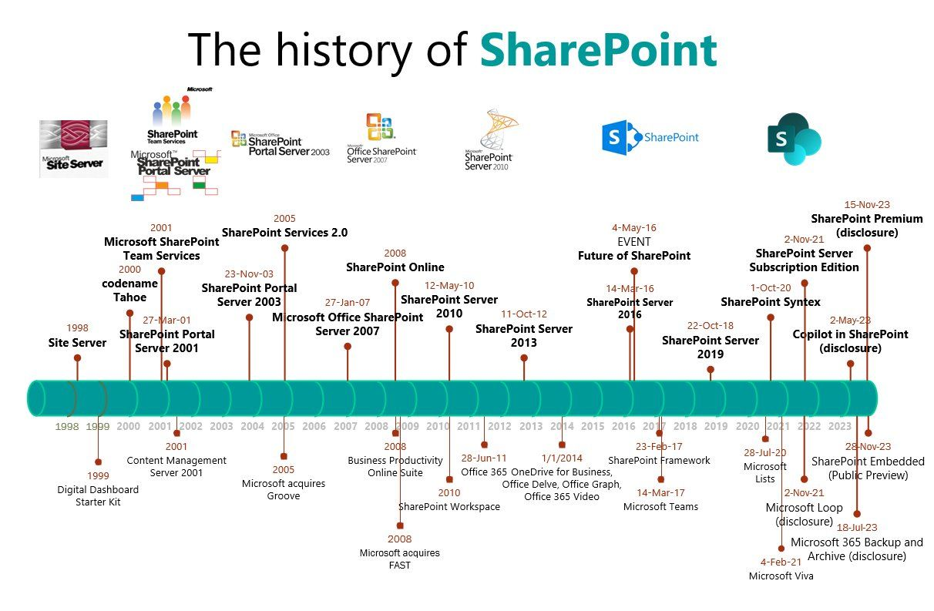

Slide 8
Identifying use cases for SharePoint
Use Case | Description | Benefits
Document Management | SharePoint can be used to store, organize, and access documents in a centralized location. Users can create libraries, folders, and metadata to categorize and manage documents. Users can also check out, edit, and version documents, as well as set permissions and workflows. | Document management with SharePoint can improve productivity, security, and compliance. Users can easily find and work on documents, as well as track changes and revisions. Users can also ensure that only authorized people can access and modify documents, and that documents adhere to the organization's policies and standards.
Team Collaboration | SharePoint can be used to create and manage team sites, where users can communicate, share information, and work together on projects. Users can create pages, lists, calendars, tasks, announcements, and other web parts to customize their team sites. Users can also use SharePoint Online to integrate with Microsoft Teams, OneDrive, and other Office 365 apps. | Team collaboration with SharePoint can enhance teamwork, communication, and innovation. Users can stay connected and informed, as well as access and update information from any device and location. Users can also leverage the features and tools of Office 365 to collaborate more effectively and efficiently.
Intranet Portal | SharePoint can be used to create and manage an intranet portal, where users can access the organization's news, resources, and services. Users can create sites, pages, and web parts to display and organize the content and functionality of the intranet portal. Users can also use SharePoint Online to integrate with Yammer, Stream, and other Office 365 apps. | Intranet portal with SharePoint can improve engagement, alignment, and performance. Users can stay updated and involved with the organization's vision, values, and goals. Users can also access and use the resources and services that support their work and development.
Notes:
SharePoint is a web-based platform that allows users to create, manage, and share content and collaborate with others. SharePoint can be used for various use cases, depending on the needs and goals of the organization or team. Here are some common use cases for SharePoint, along with their descriptions and benefits.

Slide 9
SharePoint New and improved Modern interface SharePoint 2019 Features
Feature | Modern Interface | Old Interface
Site Pages | Responsive, mobile-friendly, customizable, rich media support | Fixed, desktop-oriented, limited, no media support
Web Parts | Modular, reusable, configurable, drag-and-drop, interactive | Static, rigid, inflexible, code-based, passive
Lists and Libraries | Faster, more interactive, user-friendly, column formatting, filtering, sorting, grouping, bulk editing, Flow and PowerApps integration | Slower, less interactive, less user-friendly, no column formatting, limited filtering, sorting, grouping, no bulk editing, no Flow and PowerApps integration
Team Sites | Connected to Office 365 Groups, integrated with Microsoft Teams, modern site pages, web parts, lists, and libraries | Not connected to Office 365 Groups, not integrated with Microsoft Teams, old site pages, web parts, lists, and libraries
Communication Sites | Beautiful and engaging layout, dynamic and interactive web parts, modern site pages, lists, and libraries | No equivalent feature in the old interface
Search | Faster, smarter, personalized, relevant and contextual results, previews, filters, refiners, AI and ML powered | Slower, less smart, less personalized, less relevant and contextual results, no previews, limited filters, refiners, no AI and ML powered

Slide 10
New Development options
There are four main development options for SharePoint 2019:
SharePoint Add-ins
SharePoint Framework (SPFx)
SharePoint Server Object Model (SSOM)
SharePoint REST API and CSOM
Notes:
SharePoint Add-ins
SharePoint Add-ins are self-contained extensions that run in a separate process from SharePoint, and interact with SharePoint data and functionality through a well-defined interface. SharePoint Add-ins can be hosted on SharePoint, on a remote web server, or on Azure. They can be developed using any web development technology, such as HTML, CSS, JavaScript, ASP.NET, or PHP.
SharePoint Add-ins are ideal for scenarios where you want to:
Create isolated and secure solutions that do not affect the performance or stability of SharePoint
Use external data or services that are not available in SharePoint
Leverage existing web development skills and tools
Publish and distribute your solutions through the SharePoint Store or the App Catalog
SharePoint Framework (SPFx)
SharePoint Framework (SPFx) is a modern web development framework that enables developers to create client-side web parts and extensions that run in the context of SharePoint pages. SPFx web parts and extensions are built using open source tools and libraries, such as TypeScript, React, and webpack. They can access SharePoint data and functionality through the SharePoint REST API and CSOM, as well as external data and services through the Microsoft Graph API and Azure AD.
SPFx is ideal for scenarios where you want to:
Create responsive and dynamic user interfaces that enhance the SharePoint experience
Use modern web development practices and standards
Support mobile and cross-browser compatibility
Deploy and update your solutions without affecting the SharePoint farm
SharePoint Server Object Model (SSOM)
SharePoint Server Object Model (SSOM) is a server-side development option that allows developers to create custom solutions that run on the SharePoint server. SSOM provides access to the core SharePoint functionality and data through a rich set of classes and methods. SSOM solutions can be developed using C# or VB.NET, and deployed as farm solutions or sandboxed solutions.
SSOM is ideal for scenarios where you want to:
Create complex and powerful solutions that require full access to the SharePoint server
Use server-side code and logic to manipulate SharePoint data and functionality
Create custom timer jobs, event receivers, workflows, or web services
Use existing .NET development skills and tools
SharePoint REST API and CSOM
SharePoint REST API and CSOM are two complementary development options that allow developers to access and manipulate SharePoint data and functionality from any platform or device. The SharePoint REST API is a web service that exposes SharePoint resources and operations as HTTP endpoints, and supports JSON and OData formats. CSOM is a client-side object model that provides a wrapper around the SharePoint REST API, and supports C#, JavaScript, and Silverlight.
SharePoint REST API and CSOM are ideal for scenarios where you want to:
Create cross-platform and device-agnostic solutions that can run on any web browser, mobile app, or desktop application
Use any web development technology or language to interact with SharePoint
Integrate SharePoint with other systems or applications that support REST or OData
Use the same API for SharePoint Online and SharePoint 2019

Slide 11
Compare 2013, 2016 and 2019
Feature | SharePoint 2019 | SharePoint 2016 | SharePoint 2013
Modern user experience | Yes | No | No
Large file support (up to 15 GB) | Yes | Yes | No
Increased URL path length (up to 400 characters) | Yes | Yes | No
SharePoint Home | Yes | No | No
SharePoint Hub Sites | Yes | No | No
SharePoint Communication Sites | Yes | No | No
SharePoint Team Sites | Yes | Yes | Yes
OneDrive for Business | Yes | Yes | Yes
Microsoft Teams integration | Yes | No | No
Yammer integration | Yes | Yes | Yes
Office 365 Groups integration | Yes | No | No
Encryption at rest and in transit | Yes | Yes | No
Information rights management | Yes | Yes | Yes
Data loss prevention | Yes | Yes | No
Hybrid search | Yes | Yes | No
Hybrid taxonomy | Yes | No | No
Hybrid auditing | Yes | No | No

